Slide 1
Presentation on Twitter Sentiment Analysis using Python (NLP)
BY: Amit Shukla

Slide 2
Content
Introduction of Topic
Objectives
Tools
Research Methodology
Data analysis and interpretation
Uses
Final Thoughts

Slide 3
Introduction of Topic
Twitter Sentiment Analysis is a classification project that comes under Natural Language Processing. The objective of the project is to analyze the tweets and classify whether the tweet is positive or negative sentiment.

Slide 4
Objectives
To analyses the user's emotions by there tweets.
To keep track of what’s being said about your product or services on social media.

Slide 5
Research Methodology
Secondary data

Slide 6
Data analysis and interpretation
accuracy score(y_test,pred)
0.9433112251282693

Slide 7
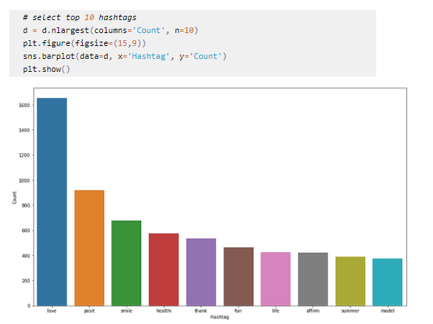
Visualization through a bar graph for top ten negative hashtags with high frequency.

Slide 8
Final Thoughts
Machines can’t process text-based data, so we have to convert to numerical form in order to process the data.
Simplifying and filtering text can achieve cleaner data to process, giving better results.
You may use different machine learning models of your preference for comparison.

Slide 9
Uses
Improve Customer Service
News Trend Analysis
Customer Feedback
Online Reputation Management

Slide 10
Thank you

